Slide 1
ADVANCED NETWORKING
INSTRUCTOR : FRED KAGAME
School Computing and IT
BIT,MSIT,CCNA,CCNP,CISA

Slide 2

CHAPTER ONE :
INTRODUCTION TO ADVANCED NETWORKING

Slide 3
Networking
Networking is the field in IT that involves connecting computers, servers, and devices to share resources and data.
covers:
Internet and intranet connectivity
IP addressing.
Routers, switches, firewalls
Protocols like TCP/IP, HTTP, FTP, etc.
LANs, WANs, and wireless network

Slide 4
Basic Networking focuses on:
Understanding how data flows in a network
Building small LANs and setting IPs
Knowing basic configurations of routers/switches
OSI model, subnetting, cabling, and basic troubleshooting

Slide 5
Advanced networking
Advanced networking goes far beyond the basic concept of simply connecting computers and devices together. It is concerned with the design, deployment, and management of highly complex, secure, and scalable network infrastructures that are capable of supporting modern applications and services.
In advanced networking, a strong emphasis is placed on understanding how data travels across the network—from the initial sender to the final receiver—by making use of different communication protocols, routing methods, and specialized devices that ensure traffic is delivered accurately and efficiently.
This field also explores how multiple technologies, such as switching, routing, virtualization, cloud networking, and wireless systems, work together to create seamless communication environments. Security, reliability, and performance optimization play a central role, as networks today must be able to handle large volumes of traffic while protecting sensitive information from cyber threats. Advanced networking, therefore, deals not only with the technical aspects of data transfer but also with the strategic planning, integration, and continuous improvement of networks to meet the ever-growing demands of modern digital communication.

Slide 6
Skill | Tools/Examples
Router & Switch Configs | Cisco CLI: configuring OSPF, EIGRP, VLANs, STP
VLAN Trunking & Inter-VLAN Routing | Setup with Cisco switches
VPN Configurations | IPSec and SSL VPNs using OpenVPN, Cisco, or FortiGate
Server Configurations | DHCP, DNS, Radius, FTP server setup on Linux or Windows Server
Hands-On Skills (Practical / Lab Configurations)

Slide 7
Network Protocol
Network protocols define a common set of rules.
A protocol in networking is a set of rules and guidelines that governs how data is transmitted between devices. Think of it as a common language that all computers on a network must speak to communicate successfully.
Can be implemented on devices in:
  Software
  Hardware
  Both
Protocols have their own:
  Function
  Format
  Rules
Protocol Type | Description
Network Communications | enable two or more devices to communicate over one or more networks
Network Security | secure data to provide authentication, data integrity, and data encryption
Routing | enable routers to exchange route information, compare path information, and select best path
Service Discovery | used for the automatic detection of devices or services
Notes:
3 – Protocols and Models
3.2 – Protocols
3.2.1 – Network Protocol Overview

Slide 8
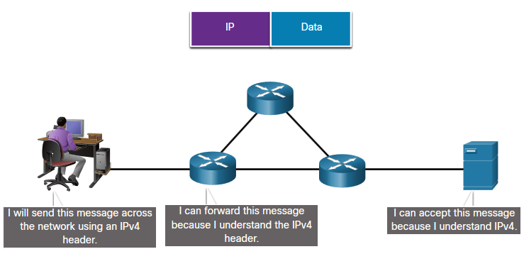
Network Protocol Functions
Devices use agreed-upon protocols to communicate .
Protocols may have one or functions.
Function | Description
Addressing | Identifies sender and receiver
Reliability | Provides guaranteed delivery
Flow Control | Ensures data flows at an efficient rate
Sequencing | Uniquely labels each transmitted segment of data
Error Detection | Determines if data became corrupted during transmission
Application Interface | Process-to-process communications between network applications
Notes:
3 – Protocols and Models
3.2 – Protocols
3.2.2 – Network Protocol Functions

Slide 9
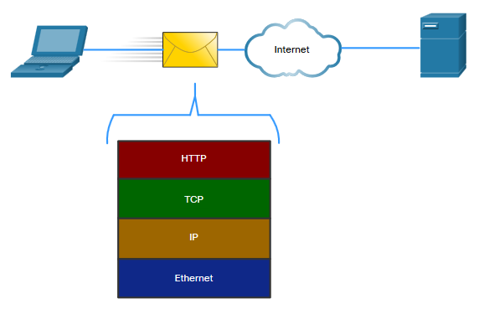
Protocol Interaction
Networks require the use of several protocols.
Each protocol has its own function and format.
Protocol | Function
Hypertext Transfer Protocol (HTTP) | Governs the way a web server and a web client interact Defines content and format
Transmission Control Protocol (TCP) | Manages the individual conversations Provides guaranteed delivery Manages flow control
Internet Protocol (IP) | Delivers messages globally from the sender to the receiver
Ethernet | Delivers messages from one NIC to another NIC on the same Ethernet Local Area Network (LAN)
Notes:
3 – Protocols and Models
3.2 – Protocols
3.2.3 – Protocol Interaction
3.2.4 – Check Your Understanding - Protocols

Slide 10
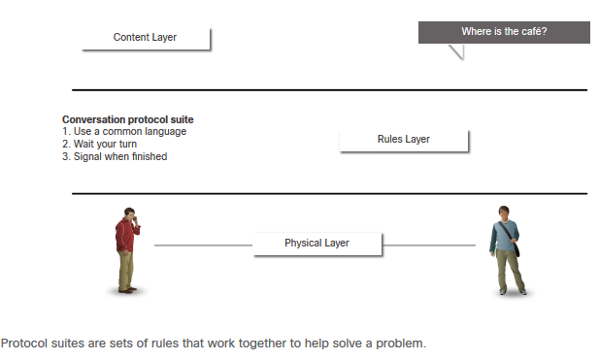
Network Protocol Suites
Protocols must be able to work with other protocols.
Protocol suite:
  A group of inter-related protocols necessary to perform a communication function
  Sets of rules that work together to help solve a problem
The protocols are viewed in terms of layers:
  Higher Layers
  Lower Layers- concerned with moving data and provide services to upper layers
Notes:
3 – Protocols and Models
3.3 – Protocol Suites
3.3.1 – Network Protocol Suites

Slide 11
OSI model and the TCP/IP model
The primary difference between the OSI model and the TCP/IP model lies in their purpose and the number of layers they use. The OSI (Open Systems Interconnection) model is a conceptual framework with seven distinct layers used for teaching and troubleshooting.
The TCP/IP (Transmission Control Protocol/Internet Protocol) model is a four-layer, practical framework that was developed for and is used by the internet.
Feature | OSI Model | TCP/IP Model
Layers | 7 (Application, Presentation, Session, Transport, Network, Data Link, Physical) | 4 (Application, Transport, Internet, Network Access)
Purpose | A theoretical reference model for understanding how networks work. | A practical model used for real-world network implementation.
Development | Developed by ISO as a formal standard before the internet was widely adopted. | Developed by the U.S. Department of Defense and became the foundation of the internet.
Flexibility | More detailed and rigid, with clear separation between functions. | More flexible, with combined layers and a focus on protocol suite functionality.
Protocols | A reference model; protocols were developed to fit the layers. | Protocol-driven; the model was created based on the protocols that already existed (e.g., TCP, IP).

Slide 12
OSI Model: The Theoretical Framework
The OSI model is a layered model that defines how a network should work, from the physical hardware up to the user-facing application. Its seven layers offer a detailed, granular view of networking processes, which makes it ideal for educational purposes and diagnosing specific network problems.
TCP/IP Model: The Practical Standard
The TCP/IP model is a more condensed and practical model that reflects how the internet was actually built. It combines several of the OSI model's layers into broader categories, making it simpler and more aligned with the protocols it was built on
The TCP/IP model is better for real-world application and implementation, as it's the foundation of the internet. The OSI model is better for teaching and troubleshooting network concepts due to its detailed, seven-layer structure

Slide 13
Advantages of Open System Interconnection (OSI) Reference Model
The OSI model is hierarchical, and there are many advantages that can be applied to any layered
model, but as I said, the OSI model’s primary purpose is to allow different vendors’ networks to
interoperate.
Here’s a list of some of the more important benefits of using the OSI layered model:
It divides the network communication process into smaller and simpler components,
facilitating component development, design, and troubleshooting.
It allows multiple-vendor development through the standardization of network components.
It encourages industry standardization by clearly defining what functions occur at each layer
of the model.
It allows various types of network hardware and software to communicate.
It prevents changes in one layer from affecting other layers to expedite development.

Slide 14
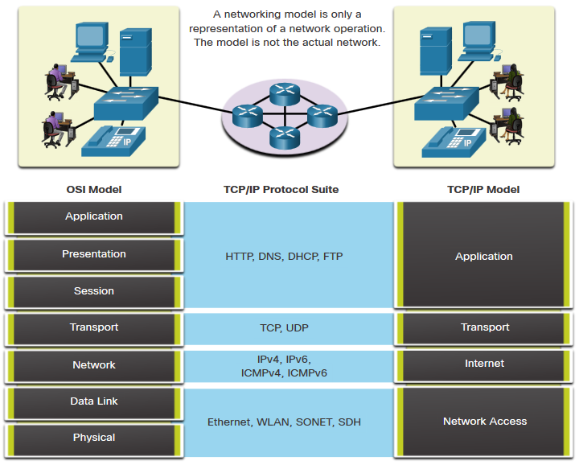
The Benefits of Using a Layered Model
Complex concepts such as how a network operates can be difficult to explain and understand. For this reason, a layered model is used.
Two layered models describe network operations:
Open System Interconnection (OSI) Reference Model
TCP/IP Reference Model
Notes:
3 – Protocols and Models
3.5 – Reference Models
3.5.1 – The Benefits of Using a Layered Model

Slide 15
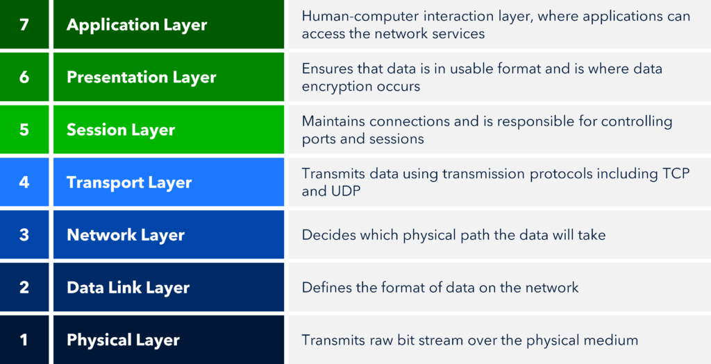

Slide 17
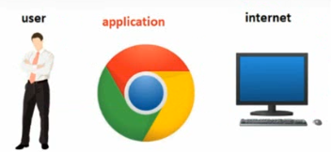
Application Layer
Provides interface between the user and the internet.
When a user wants to access internet, they use applications such as chrome, Mozilla Firefox, Gmail, Facebook, twitter etc.
The layer provides services like sending mails, transferring files, web browsing, working of social media, video chatting, etc.
The Application layer works as the interface between actual application
programs. This means end-user programs like Microsoft Word don’t reside at the
Application layer, they interface with the Application layer protocols.
Real-life analogy: Writing a letter. This is where you, the user, write the content of the letter. It's what the user sees and interacts with.

Slide 18
2. Presentation Layer
It presents data to the Application layer and is responsible for data translation and code formatting.
Carries out the following tasks;
i. Encoding and Decoding
Encoding transforms the human-readable texts into computer-readable binary format. E.g. “Hi Dan ” into 0010011101
Decoding will therefore change this binary format into human-readable texts, now; 0010011101 into “Hi Dan”
ii. Encryption and Decryption
Encryption uses encryption key algorithms to change users passwords into formats that cannot be understood. E.g. Dan@2021 into s3#ff92!!42gdL
Decryption uses decryption key algorithms to change the encrypted password back to understandable format. E.g. s3#ff92!!42gdL into Dan@2021
iii. Compression and Decompression
Compression happens on the sender side to reduce the size of data while sending e.g. 2gb to1gb
Decompression happens on the receiver side to regain the original data size sent e.g. 1gb to 2gb

Slide 19
Real-life analogy: Translating and formatting. If you're sending the letter to someone who speaks a different language, this is where you would translate it. You might also convert it to a particular format, like typing or handwriting.

Slide 20
3. Session Layer
The layer creates a logical or virtual path between the source and destination.
Provides services to the presentation layer and to manage data exchange.
Carries out the following tasks;
Start the Session
First the layer creates the logical path between the sender and receiver.
Then it initiates the sending and receiving of data.
ii. Manage the Session
Takes care or monitor the logical path created during data communication. Protects the logical path.
iii. End the Session
When the sending and receiving is finished, it closes the logical path.
Function: Establishes, manages, and terminates communication sessions between devices.
Real-life analogy: Opening and closing the envelope. Before the letter can be sent, you need to put it in an envelope (start the session), and when it's received, someone will open the envelope to read the letter (end the session).

Slide 21
The Session layer is responsible for setting up, managing, and dismantling sessions between
Presentation layer entities and keeping user data separate. Dialog control between devices also
occurs at this layer.
Communication between hosts’ various applications at the Session layer, as from a client to a
server, is coordinated and organized via three different modes: simplex, half-duplex, and fullduplex.
Simplex is simple one-way communication, kind of like saying something and not getting
a reply.
Half-duplex is actual two-way communication, but it can take place in only one direction
at a time, preventing the interruption of the transmitting device. It’s like when pilots and ship
captains communicate over their radios, or even a walkie-talkie. But
full-duplex is exactly like a real conversation where devices can transmit and receive at the same time, much like two people arguing or interrupting each other during a telephone conversation.

Slide 22
4. Transport Layer
Defines services to segment, transfer, and reassemble the data for individual communications.
Carries out the following tasks;
Segmentation and Reassembling
Segmentation happens on the sender side to break the original big data into segments/small pieces before sending. Data is sent as segments. E.g. “ Bring it Dan” is sent as segments ‘Bring’ ‘it’ ‘Dan’
Reassembling happens on the receiver side to collect the data pieces/segments together to form the original data. The individual segments of ‘Bring’ ‘it’ ‘Dan’ is put back to “ Bring it Dan”.
ii. Flow Control
Manages the flow of data speed while sending and receiving data. Ensures that the transfer speed of both sending and receiving devices is matching.
iii. Error Control
In case there is data loss during the transfer process, the sender resends the data.

Slide 23
Function: Ensures that data is sent and received correctly, handling error correction and data flow control. This includes protocols like TCP or UDP.
Real-life analogy: Ensuring the letter is delivered correctly. This is like using a registered mail service that ensures your letter will be delivered, perhaps with a tracking number, and that the contents of the letter will arrive in the correct order and unbroken

Slide 24
Connection-Oriented Communication
For reliable transport to occur, a device that wants to transmit must first establish a connection oriented
communication session with a remote device—its peer system—known as a call setup or
a three-way handshake. Once this process is complete, the data transfer occurs, and when it’s
finished, a call termination takes place to tear down the virtual circuit.
The first “connection agreement” segment is a request for synchronization (SYN).
The next segments acknowledge (ACK) the request and establish connection parameters—the rules between hosts. These segments request that the receiver’s sequencing is synchronized.
here as well so that a bidirectional connection can be formed.
The final segment is also an acknowledgment, which notifies the destination host that the connection agreement has been accepted and that the actual connection has been established. Data transfer can now begin.

Slide 25
5. Network Layer
Carried out by routers or layer-three switches.
Provides services to exchange the individual pieces of data over the network.
Carries out the following tasks;
Routing
Uses a router to connect one network to another network. Connecting different networks.
ii. Assigning IP address
Assigns source IP and destination IP addresses to data being transfered.
iii. Select Best Path
When there is multiple paths to the destination, the router will choose the best path to send data.
Function: Routes data from the source to the destination. This is where IP addresses and routing come into play.
Real-life analogy: Choosing the route. This is like selecting which postal service to use, which transport routes will be taken, and determining the destination address (like an IP address) for the letter.

Slide 26
Route Update Packets These packets are used to update neighboring routers about the networks connected to all routers within the internetwork. Protocols that send route update packets are called routing protocols; the most critical ones for CCNA are RIPv2, EIGRP, and OSPF. Route update packets are used to help build and maintain routing tables.
shows an example of a routing table. The routing table each router keeps and refers
to includes the following information:

Slide 27
6. Data Link Layer
Carried out by layer-two switches.
Carries out the following tasks;
Framing
Inserts header (at the start) and trailer (at the end) into the data. These are information that helps the data to reach safely to destination.
ii. Adding and Deleting MAC Addresses
Adds the source MAC and destination MAC addresses to data while sending.
Once the data is received, it removes these addresses.
iii. Flow Control
Manages the flow of data speed while sending and receiving data. Ensures that the transfer speed of both sending and receiving devices is matching.
iv. Error Control
In case there is data loss during the transfer process, the sender resends the data.

Slide 28
The Data Link Layer
The Data Link layer provides for the physical transmission of data and handles error notification, network topology, and flow control.
This means that the Data Link layer will ensure that messages are delivered to the proper device on a LAN using hardware addresses and will translate messages from the Network layer into bits for the Physical layer to transmit.
The Data Link layer formats the messages, each called a data frame, and adds a customized
header containing the hardware destination and source address.
This added information forms a sort of capsule that surrounds the original message in much the same way that engines navigational devices, and other tools were attached to the lunar modules of the Apollo project.
These various pieces of equipment were useful only during certain stages of space flight and were stripped off the module and discarded when their designated stage was completed.
The process of data traveling through networks is similar.

Slide 29
IEEE
IEEE stands for Institute of Electrical and Electronics Engineers.
It is the world’s largest professional technical organization, dedicated to advancing technology in areas such as electrical engineering, electronics, computer science, and telecommunications.
IEEE develops standards, publishes research journals, organizes conferences, and supports education and innovation.
Importance in Networking
In networking, IEEE is best known for its standards, for example:
IEEE 802.3 → Ethernet (LAN)
IEEE 802.11 → Wi-Fi (WLAN)
IEEE 802.1Q → VLAN (Virtual LANs)
IEEE 802.15 → Bluetooth (PAN)

Slide 30
shows the Data Link layer with the Ethernet and IEEE specifications. When you check it out, notice that the IEEE 802.2 standard is used in conjunction with and adds functionality to the other IEEE standards.
IEEE 802.3 (Ethernet MAC) → Defines framing, addressing, and media access.
IEEE 802.2 (LLC) → Provides extra intelligence, telling the system how to handle the data and allowing multiple protocols to share the network.

Slide 31
The IEEE Ethernet Data Link layer has two sublayers:
Media Access Control (MAC) Defines how packets are placed on the media. Contention for
media access is “first come/first served” access where everyone shares the same bandwidth—
hence the name. Physical addressing is defined here as well as logical topologies. What’s a logical
topology? It’s the signal path through a physical topology. Line discipline, error notification (but
not correction), the ordered delivery of frames, and optional flow control can also be used at this
sublayer.
Logical Link Control (LLC) Responsible for identifying Network layer protocols and then
encapsulating them. An LLC header tells the Data Link layer what to do with a packet once a
frame is received. It works like this: a host receives a frame and looks in the LLC header to find
out where the packet is destined—for instance, the IP protocol at the Network layer. The LLC can
also provide flow control and sequencing of control bits.

Slide 32
As data is encoded with control information at each layer of the OSI model, the data is named with something called a protocol data unit (PDU). At the Transport layer, the PDU is called a segment, at the Network layer it’s a packet, at the Data Link a frame, and at the Physical layer it’s called bits.
IEEE and the Data Link Layer
IEEE divides the Data Link Layer into two sublayers:
LLC (Logical Link Control) – defined by IEEE 802.2
Provides an interface between the Network Layer and MAC.
Adds flow control and error detection.
Ensures multiple Layer 3 protocols (IP, IPX, AppleTalk, etc.) can share the same physical network.
MAC (Media Access Control) – defined by standards like IEEE 802.3 (Ethernet), 802.11 (Wi-Fi), etc.
Defines how frames are placed on the medium (cable or air). Uses MAC addresses for unique identification and Controls who can access the medium (CSMA/CD in Ethernet, CSMA/CA in Wi-Fi).

Slide 33
Scenario: Sending an Email Over Ethernet
Imagine you’re in an office connected via Ethernet (IEEE 802.3):
You send an email from your laptop.
  The application hands data down the stack until it reaches the Network Layer (IP).
Network Layer → Data Link Layer
  IP packet arrives at the Data Link Layer.
  LLC (IEEE 802.2) identifies that the payload is an IPv4 packet.
  LLC adds headers to tell the receiver’s Data Link Layer how to interpret the payload.
MAC Sublayer (IEEE 802.3)
  The MAC adds source and destination MAC addresses.
  Implements CSMA/CD to ensure the medium is free before sending. And Builds an Ethernet Frame with preamble, headers, data, and CRC.
Physical Layer (Layer 1)
  The frame is converted to electrical signals on copper cable (or light on fiber).
Receiving Device
  The NIC receives the frame, checks the CRC for errors. The MAC checks if the destination MAC matches.
  LLC delivers the payload to the Network Layer (IP).
  IP forwards it up to the email application.

Slide 34
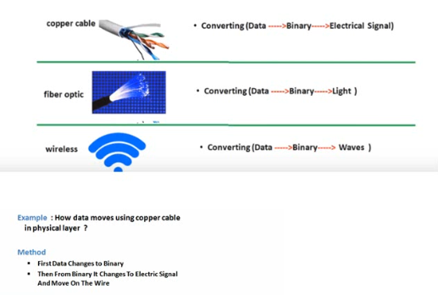
7. Physical Layer
Interacting with the hardware devices and physical components Hardware components are like router, switches, hub etc. Physical components are like cables. Ports, connectors etc.
Converts the data into various forms as shown below;
Describes methods for exchanging data frames over a common media.

Slide 35
The Physical Layer
Finally arriving at the bottom, we find that the Physical layer does two things: it sends bits and
receives bits. Bits come only in values of 1 or 0—a Morse code with numerical values. The
Physical layer communicates directly with the various types of actual communication media.
Different kinds of media represent these bit values in different ways. Some use audio tones, while
others employ state transitions—changes in voltage from high to low and low to high. Specific
protocols are needed for each type of media to describe the proper bit patterns to be used, how
data is encoded into media signals, and the various qualities of the physical media’s attachment
interface.
Latency is the time measured from when a frame enters a port to when it exits a port.

Slide 36
Hub
A multiport repeater.
Simply takes an incoming signal and repeats/broadcasts it to all other ports.
No MAC address, no frame processing.
Belongs to the Physical Layer (Layer 1).
Repeater
Regenerates/amplifies electrical/optical signals to extend distance.
Does not understand frames or addresses.
Also belongs to the Physical Layer (Layer 1).
Difference with Data Link Layer (Layer 2) Devices
Devices like Switches and Bridges operate at Layer 2 (Data Link Layer) because they look at MAC addresses and make forwarding decisions.
Hubs/Repeaters do not — they only deal with raw bits/signals.

Slide 37
Topologies at the Physical layer
One last thing I want to discuss at the Physical layer is topologies, both physical and logical.
Understand that every type of network has both a physical and a logical topology.
The physical topology of a network refers to the physical layout of the devices, but mostly
the cabling and cabling layout.
The logical topology defines the logical path on which the signal will travel on the physical
topology.

Slide 38
Here are the topology types, although the most common, and pretty much the only network we
use today is a physical star, logical bus technology, which is considered a hybrid topology (think
Ethernet):
Bus: In a bus topology, every workstation is connected to a single cable, meaning every host
is directly connected to every other workstation in the network.
Ring: In a ring topology, computers and other network devices are cabled together in a way
that the last device is connected to the first to form a circle or ring.
Star: The most common physical topology is a star topology, which is your Ethernet
switching physical layout. A central cabling device (switch) connects the computers and other
network devices together. This category includes star and extended star topologies. Physical
connection is commonly made using twisted-pair wiring.
Mesh: In a mesh topology, every network device is cabled together with connection to each
other. Redundant links increase reliability and self-healing. The physical connection is
commonly made using fiber or twisted-pair wiring.
Hybrid: Ethernet uses a physical star layout (cables come from all directions), and the signal
travels end-to-end, like a bus route.

Slide 39
OSI Data Types and Protocols
NO | Layer | Devices | Protocols | Data Types
1 | Physical | Hub, modem, cables, network cards, connectors etc. | Bluetooth, DSL, Ethernet etc. | Bits
2 | Data Link | Bridge Switch | ARP, ATM, FDDI, Frame Relay, | Frames
3 | Network | Router Layer-three switch | ICMP, IGMP, IPv4,IPv6, IPsec | Packets
4 | Transport | Software layers We use applications. | TCP UDP | Segments
5 | Session |  | NetBIOS, PAP, NFS | Data
6 | Presentation |  | JPEG, MIDI, GIFF, TIFF | Data
7 | Application |  | HTTP, SNMP, Telnet, DNS | Data

Slide 40
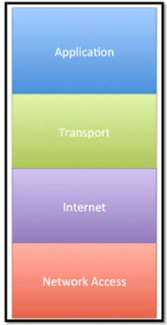
TCP/IP Model--5
This is a method that shows how data moves over the internet, just like OSI.
Developed in 1978.
Has only four layers.

Slide 41
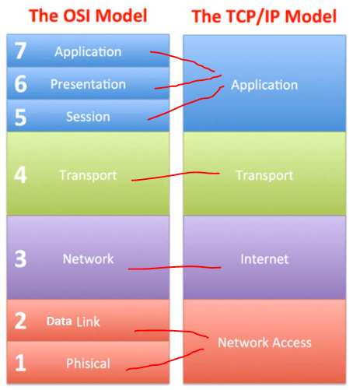
Comparison with OSI Model
OSI has 7 layers while TCP/IP has 4 layers.
The TCP/IP layers function as all the OSI 7 layers.
Below diagram shows corresponding layers implementing the functionalities discussed under OSI layers.

Slide 42
The TCP/IP Reference Model
TCP/IP Model Layer | Description
Application | Represents data to the user, plus encoding and dialog control.
Transport | Supports communication between various devices across diverse networks.
Internet | Determines the best path through the network.
Network Access | Controls the hardware devices and media that make up the network.
Notes:
3 – Protocols and Models
3.5 – Reference Models
3.5.3 – The TCP/IP Reference Model

Slide 43
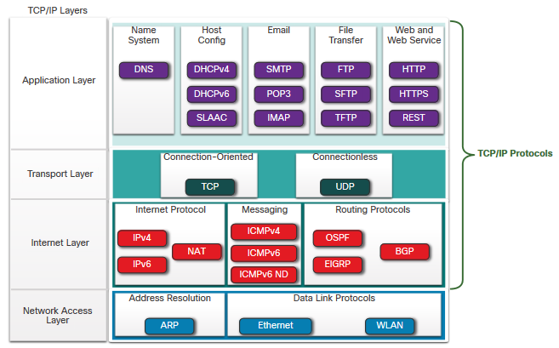
TCP/IP Protocol Suite
TCP/IP is the protocol suite used by the internet and includes many protocols.
TCP/IP is:
An open standard protocol suite that is freely available to the public and can be used by any vendor
A standards-based protocol suite that is endorsed by the networking industry and approved by a standards organization to ensure interoperability
Notes:
3 – Protocols and Models
3.3 – Protocol Suites
3.3.4 – TCP/IP Protocol Suite

Slide 44
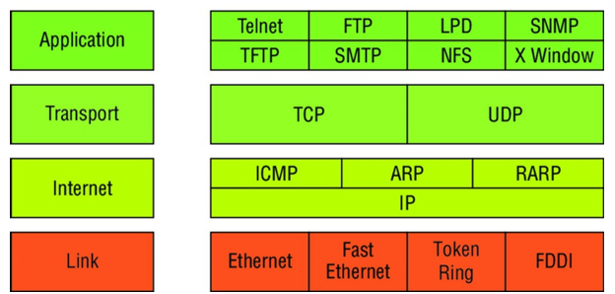
TCP/IP is basically a condensed version of the OSI model that comprises four instead of seven layers:
Process/Application layer
Host-to-Host layer or Transport layer
Internet layer
Network Access layer or Link layer
Layers Protocols

Slide 45
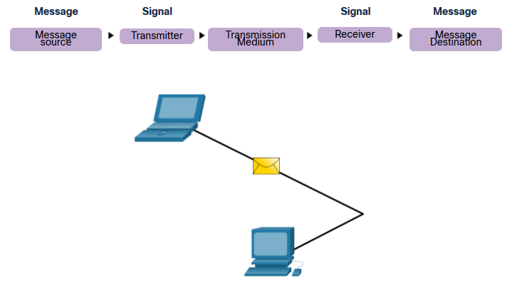
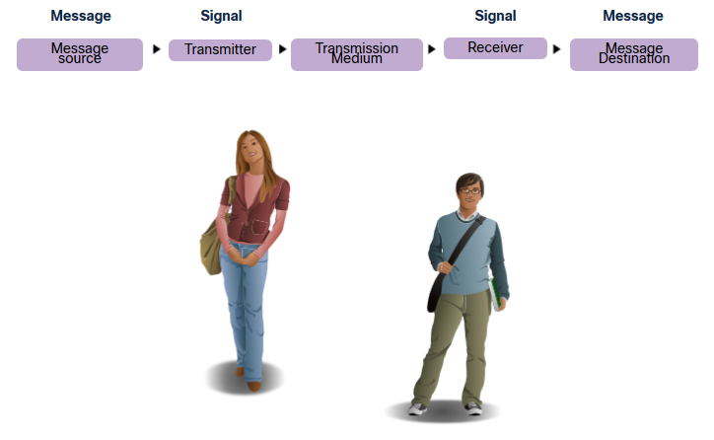
Communications Protocols
All communications are governed by protocols.
Protocols are the rules that communications will follow.
These rules will vary depending on the protocol.
Notes:
3 – Protocols and Models
3.1 – The Rules
3.1.3 – Communications Protocols

Slide 46
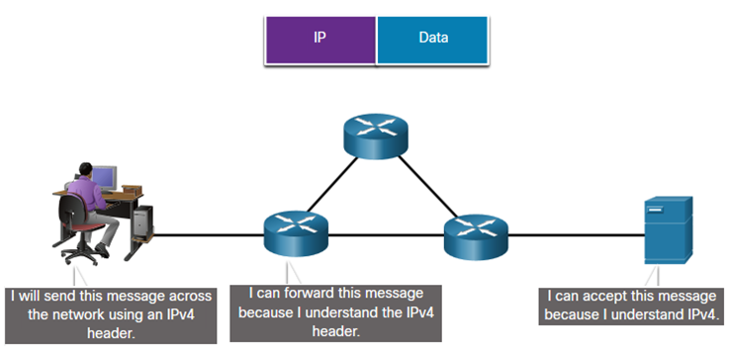

Slide 47
OSI Questions
Answer the following questions about the OSI model:
1. Which layer chooses and determines the availability of communicating partners along with
the resources necessary to make the connection, coordinates partnering applications, and
forms a consensus on procedures for controlling data integrity and error recovery?
2. Which layer is responsible for converting data packets from the Data Link layer into electrical
signals?
3. At which layer is routing implemented, enabling connections and path selection between two
end systems?
4. Which layer defines how data is formatted, presented, encoded, and converted for use on the
network?
5. Which layer is responsible for creating, managing, and terminating sessions between
applications?
6. Which layer ensures the trustworthy transmission of data across a physical link and is
primarily concerned with physical addressing, line discipline, network topology, error
notification, ordered delivery of frames, and flow control?

Slide 48
7. Which layer is used for reliable communication between end nodes over the network and
provides mechanisms for establishing, maintaining, and terminating virtual circuits;
transport-fault detection and recovery; and controlling the flow of information?
8. Which layer provides logical addressing that routers will use for path determination?
9. Which layer specifies voltage, wire speed, and cable pinouts and moves bits between devices?
10. Which layer combines bits into bytes and bytes into frames, uses MAC addressing, and
provides error detection?
11. Which layer is responsible for keeping the data from different applications separate on the
network?
12. Which layer is represented by frames?
13. Which layer is represented by segments?
14. Which layer is represented by packets?
15. Which layer is represented by bits?
16. Rearrange the following in order of encapsulation:
Packets, Frames ,Bits, Segments

Slide 49
17. Which layer segments and reassembles data into a data stream?
18. Which layer provides the physical transmission of the data and handles error notification,
network topology, and flow control?
19. Which layer manages logical device addressing, tracks the location of devices on the
internetwork, and determines the best way to move data?
20. What is the bit length and expression form of a MAC address?

